Slide 1
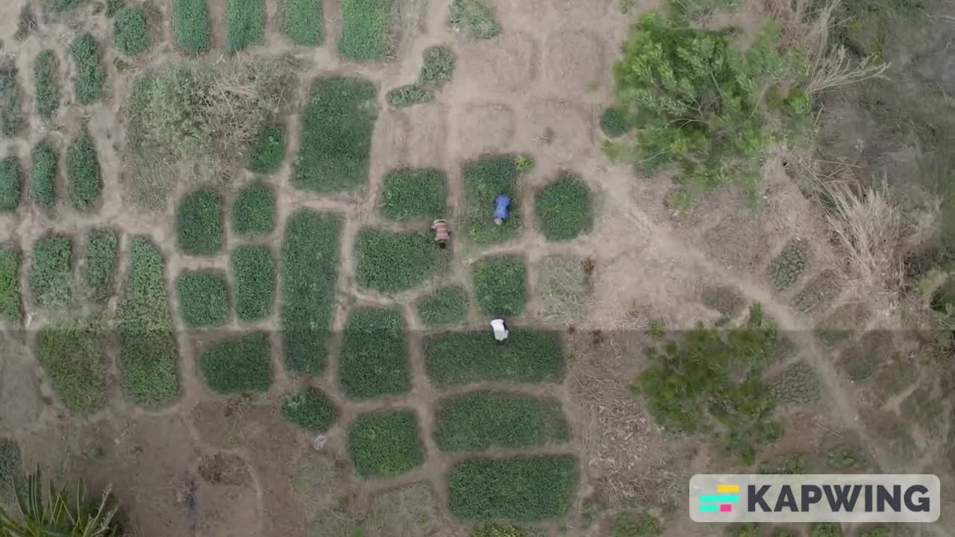

Slide 2


Presented by The Mavericks
THE IMPACT OF CLIMATE CHANGE ON AGRICULTURE
Ensuring Food Security for Future Generations

Slide 3
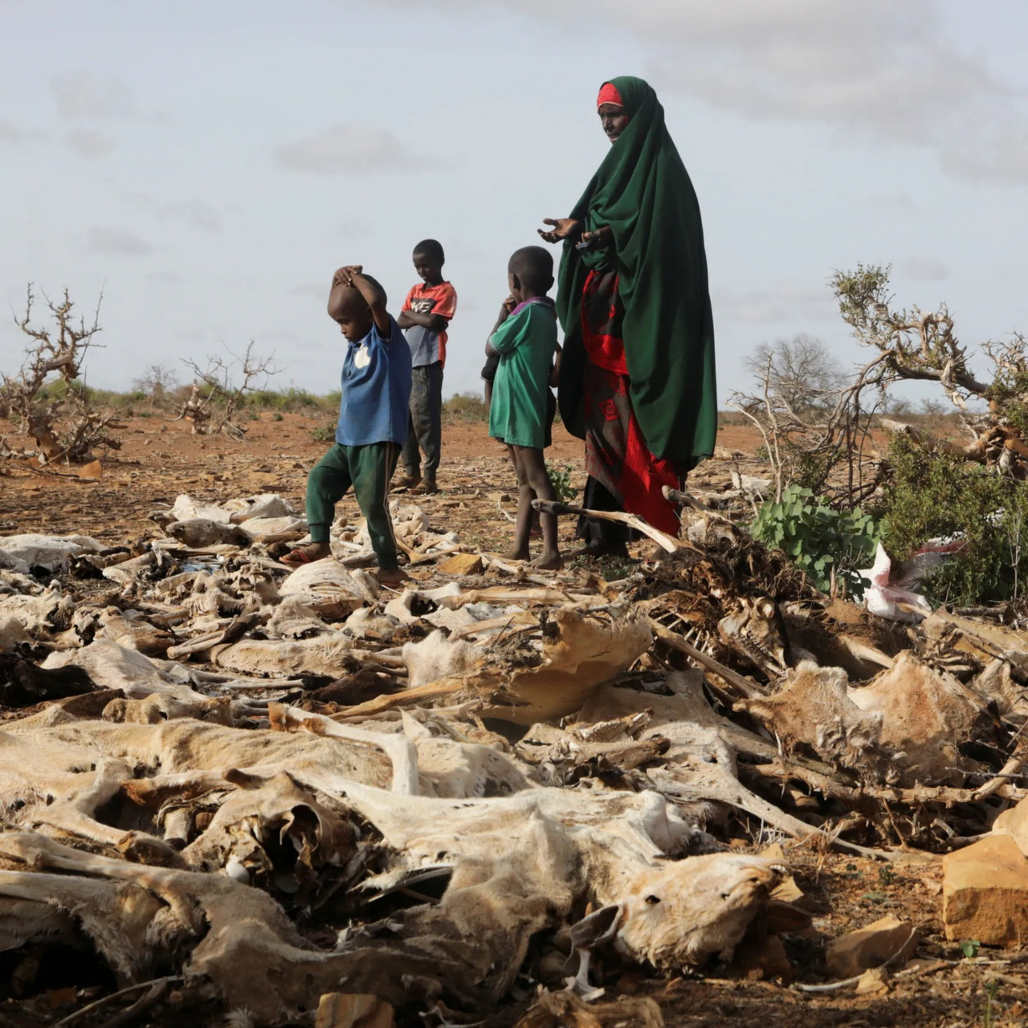
OUTLINE
INTRODUCTION
PROBLEM STATEMENT
DATA OVERVIEW
METHODOLOGY
ANALYSIS & INSIGHTS
CONCLUSION
MEET THE TEAM
ACKNOWLEDGEMENT
THANK YOU
REFERENCES

Slide 4
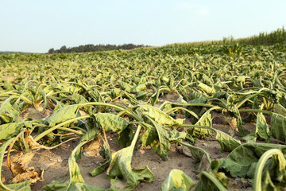
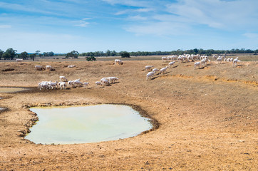
INTRODUCTION
This presentation explores the impact of climate change on agriculture, utilizing data from various countries.
Climate Change refers to a long-term shifts in temperature and weather patterns.

Slide 5
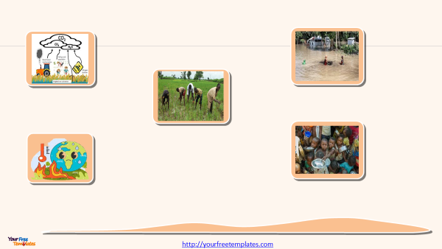
GLOBAL STATISTICS
AGRICULTURE CONTRIBUTES UP TO 24% OF GLOBAL GREENHOUSE GAS EMISSIONS . 【FAO, 2021】
CLIMATE-RELATED DISASTERS HAVE INCREASED BY 83% BETWEEN 2000 & 2020 COMPARED TO THE PREVIOUS TWO DECADES. 【WMO, 2020】
AGRICULTURE EMPLOYS 60% OF THE WORKFORCE AND CONTRIBUTES 23% TO GDP IN SUB-SAHARAN AFRICA AND SOUTH ASIA. 【UNDP, 2023】
WITH A GLOBAL TEMPERATURE RISE OF 1.5°C ABOVE PRE-INDUSTRIAL LEVELS, YIELDS OF STAPLE CROPS COULD DROP BY 6-8%. 【IPCC, 2019】
CLIMATE CHANGE COULD PUSH AN ADDITIONAL 100 MILLION PEOPLE INTO POVERTY BY 2030, PRIMARILY FROM AGRICULTURAL COMMUNITIES. 【WORLD BANK, 2016】

Slide 6




KEY FACTORS
Average global temperatures have risen by approximately 1.2°C since the late 19th century.
Optimal temperature for wheat growth is between 15°C - 20°C; yields decline sharply above 25°C.
CO2 EMISSIONS IMPACT
RISING TEMPERATURES
PRECIPITATION PATTERNS
Changes in rainfall affect crop viability
:
Regions with low precipitation face higher risks of drought and reduced yields.
Increased CO2 can enhance photosynthesis but does not guarantee higher yields.
.

Slide 7
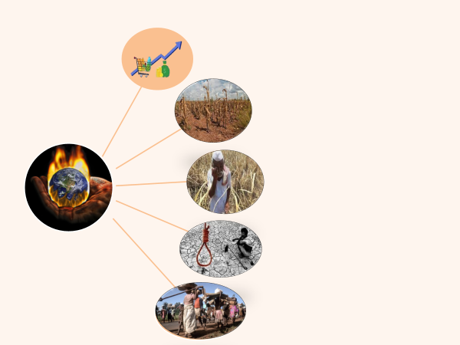
Increased food prices
Lower yields of crops could
lead to economic instability
ECONOMIC
CONSEQUENCES
Financial losses for farmers
Farmers committing suicide as
a result of low crop yields
Causing climate migration in the Northern part of Ghana

Slide 8
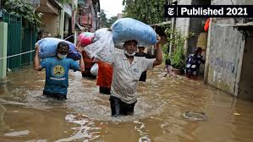
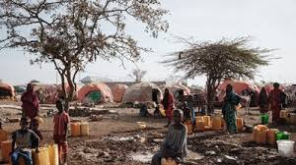

VULNERABLE REGIONS
Sub-Saharan Africa is particularly vulnerable due to:
High temperatures and low precipitation
Limited irrigation access and adaptation strategies
Example:
Nigeria (North West):
Average temperature of 21.23°C for barley with only 25.74% irrigation access.
Economic impact of $167 million due to climate challenges.

Slide 9
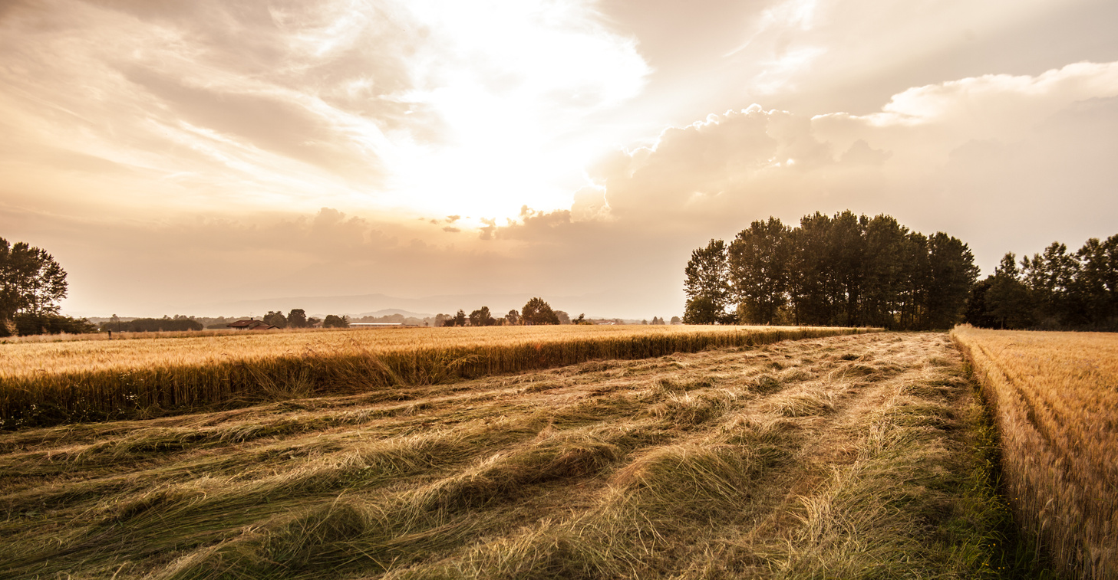

PROBLEM STATEMENT
Climate change poses a significant threat to global food security , leading to reduced crop yields, economic losses, and food shortages.

Slide 10
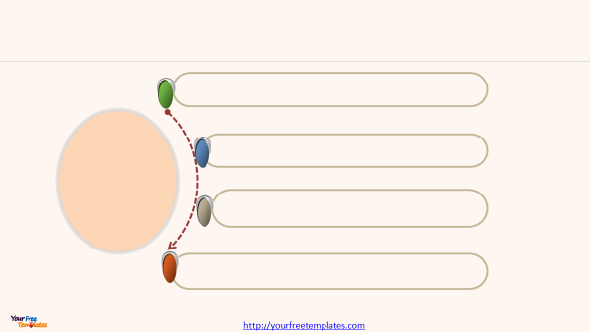
To Analyze historical climate data , to identify trends
and key variables affecting crop yields
To use Python for exploratory data analysis
and machine learning
OBJECTIVES
To develop predictive models that provides insights for sustainable Agriculture planning and resilience
Recommend policies that help mitigate the impact
of climate change on Agriculture

Slide 11
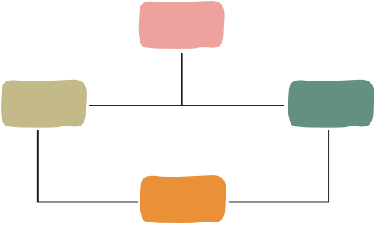
DATA OVERVIEW
DATA DIMENSIONS
10000 X 15
DATA SOURCE
KAGGLE
SEGMENTS
10 COUNTRIES
10 CROP TYPES
CLIMATE INDICATORS

Slide 12
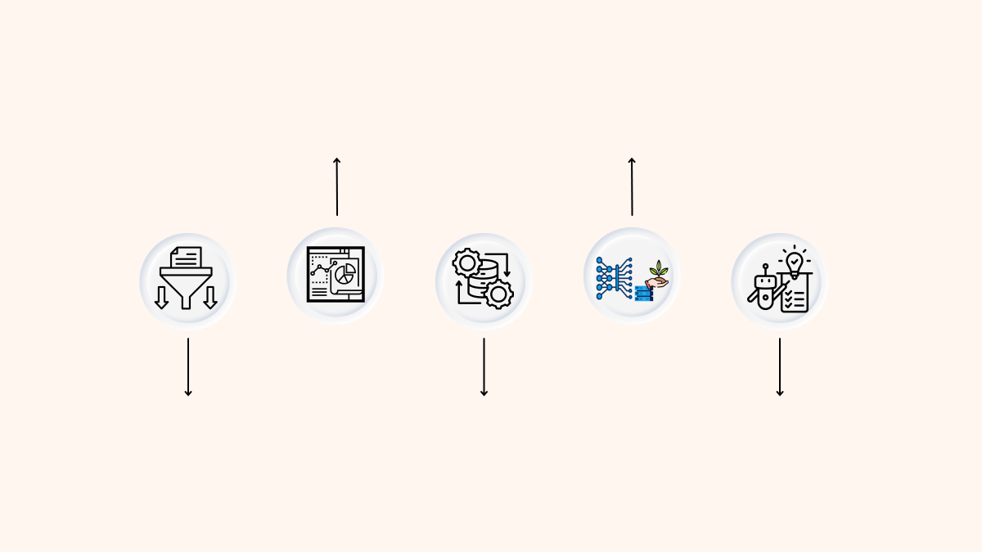
METHODOLOGY
Exploratory Data Analysis
Model Building
Data Extraction
Data Preprocessing
Model Evaluation and Selection

Slide 13
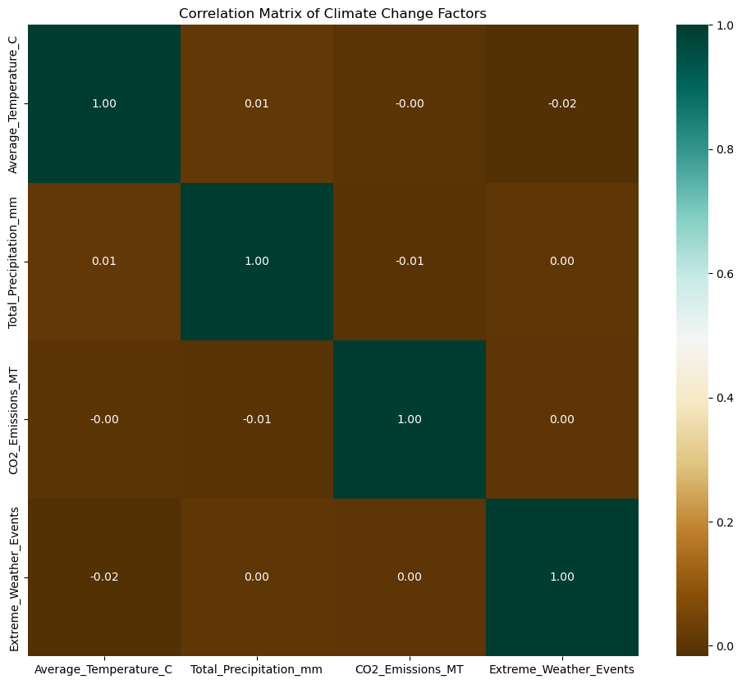
Both the Spearman and Pearson correlations were explored to find the relationship between the feature variables and we observed that there was no strong relationships between these variables
CORRELATION MATRIX

Slide 14
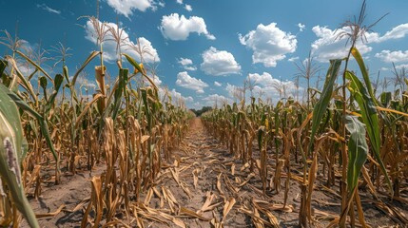
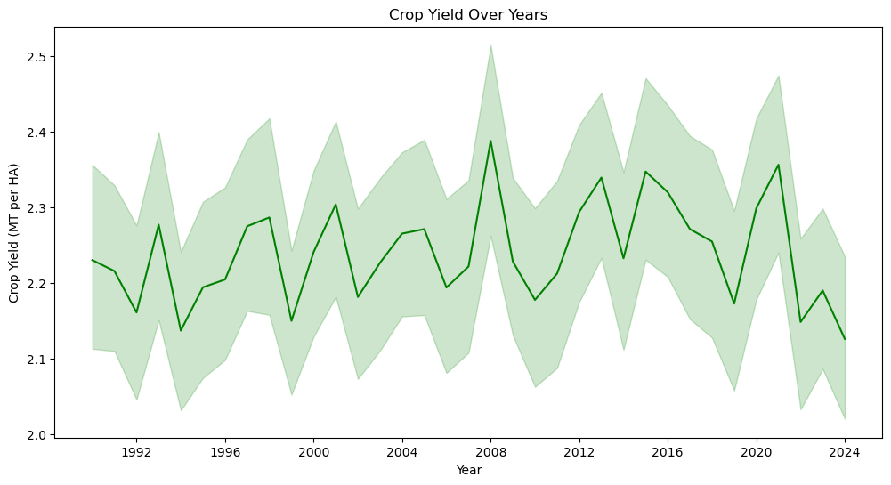
CROP YIELD TREND

Slide 15
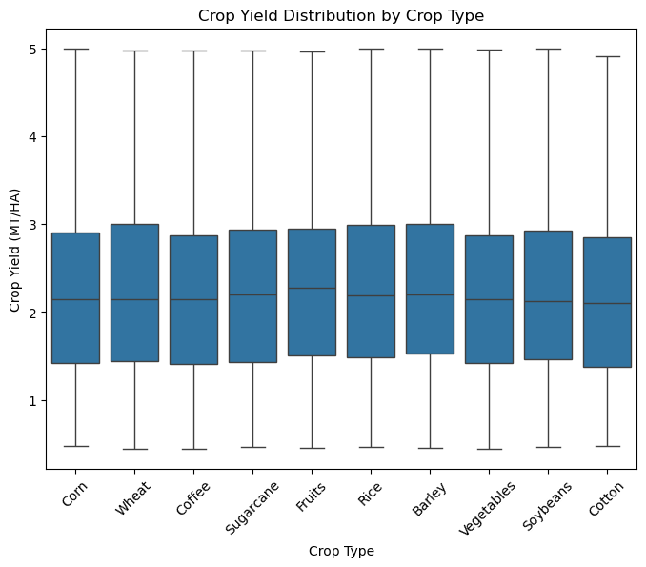
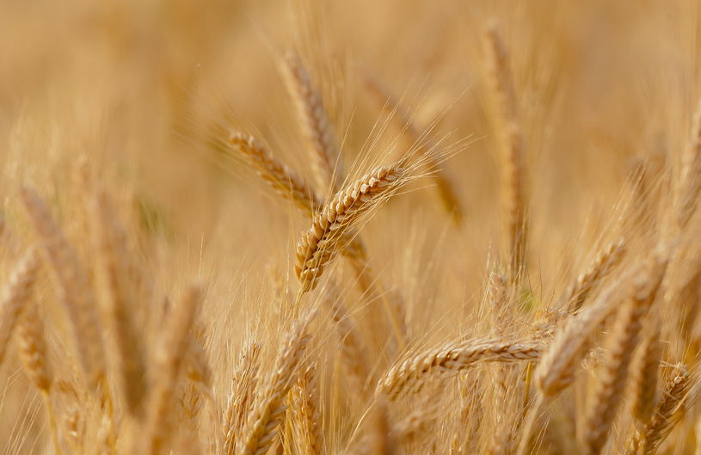
CROP YIELD DISTRIBUTION
BY CROP TYPE

Slide 16
MODEL PERFORMANCES
Model | MSE Results | MAE Results
Random Forest Regressor | 0.722 | 0.717
Decision Tree Regressor | 1.393 | 0.948
XGBoost Regressor | 0.794 | 0.744
Support Vector Regressor | 0.830 | 0.762
LightGBM Regressor | 0.709 | 0.714
K-Nearest Neighbors Regressor | 0.881 | 0.770
Linear Regression | 0.880 | 0.773
Gradient Boosting Regressor | 0.677 | 0.701

Slide 17
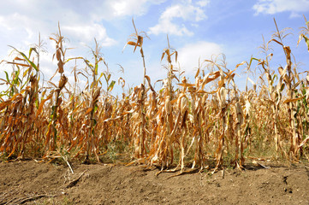
MODEL SELECTION AND RELEVANCE
The Gradient Boosting Regressor was selected because it was more relevant for the purpose of our study.
The relevance of our model is to predict crop yield based on influencing factors to help make informed decision on What to grow, When to grow and What to do to improve yield

Slide 18
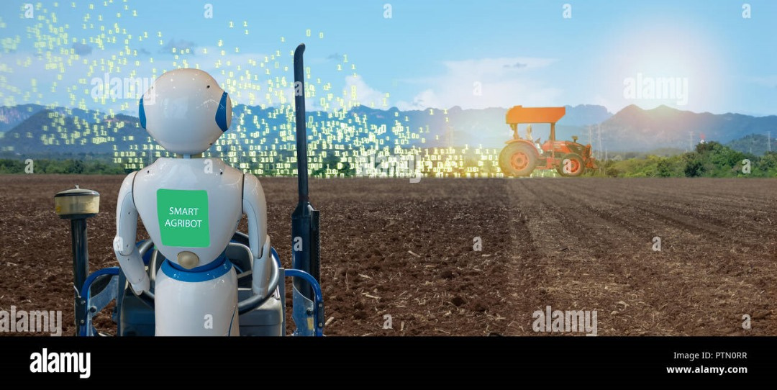
LIMITATIONS & FUTURE PROJECTION
Most of our models produced relatively high mean squared errors . Consequently, future efforts will focus on enhancing model performance by exploring alternative techniques.

Slide 19
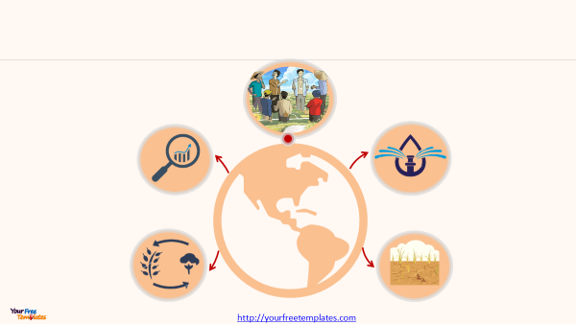
RECOMMENDATIONS
DEPLOY AGRICULTURE EXTENSION OFFICERS S TO ASSIST FARMERS .
ENGAGE DATA ANALYSTS IN THE AGRICULTURE SECTOR TO DEVELOP MODELS FOR PREDICTING CROP YIELDS.
LEVERAGE EFFICIENT IRRIGATION SYSTEMS TO HELP MAINTAIN SOIL MOISTURE LEVELS.
CROP ROTATION SHOULD BE EXPLORED BY FARMERS TO IMPROVE SOIL HEALTH.
FARMERS CAN OPT FOR DROUGHT-RESISTANT VARIETIES.

Slide 20
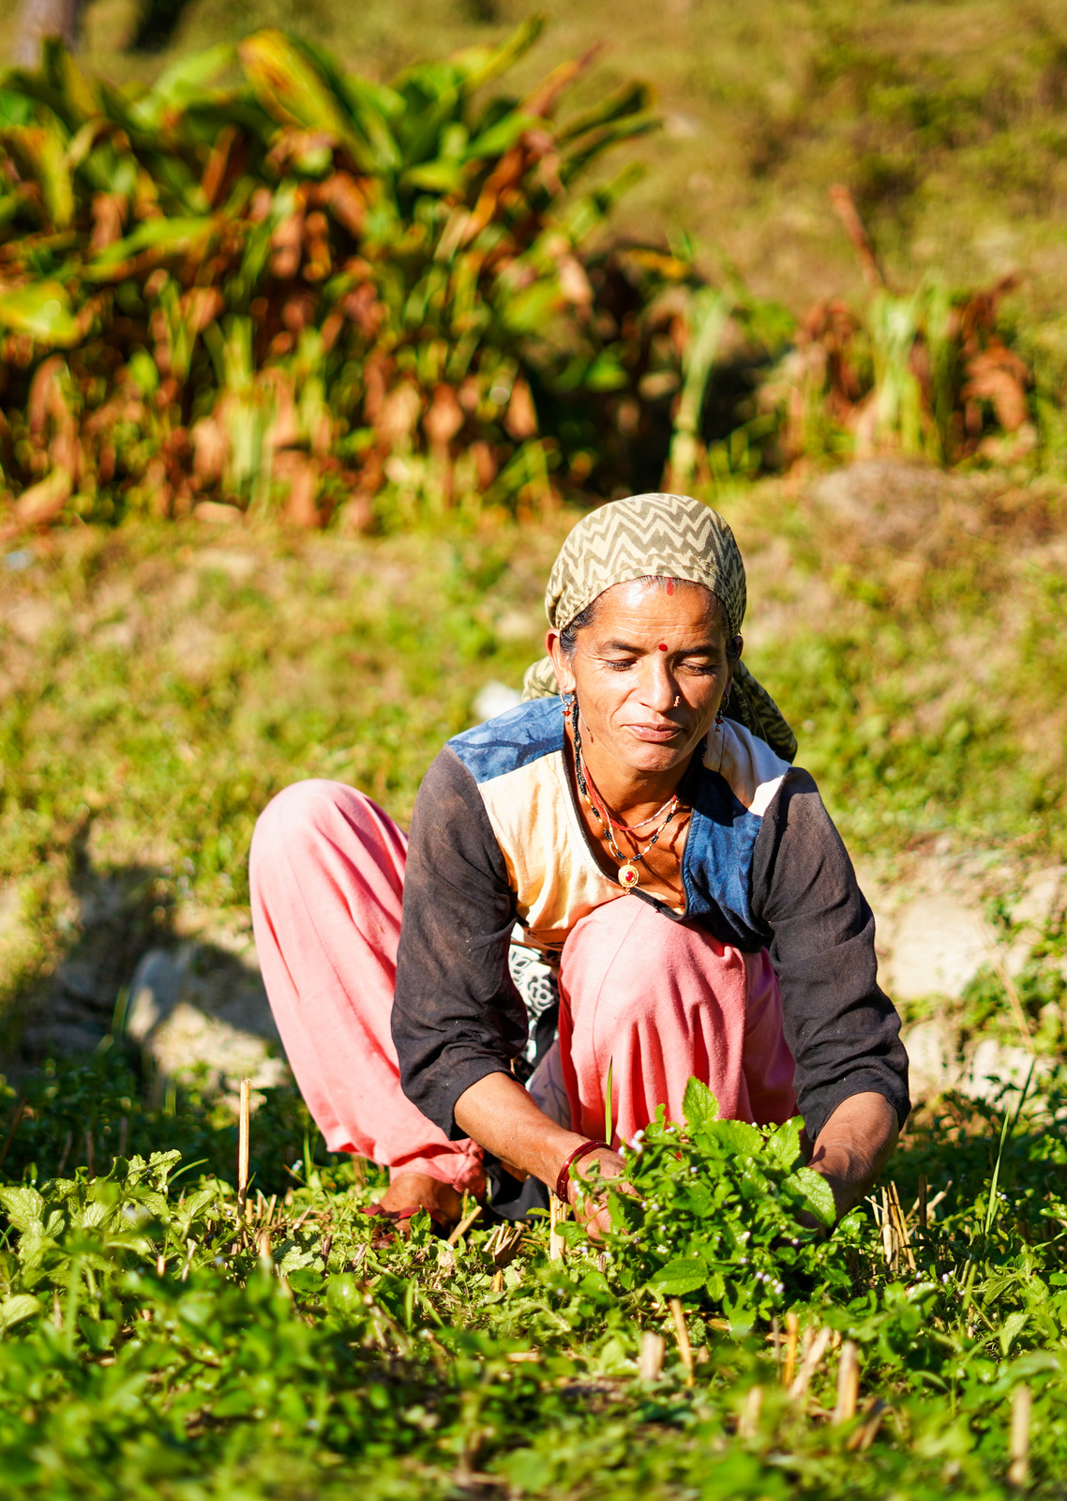
CONCLUSION
CLIMATE CHANGE POSES SIGNIFICANT RISKS TO GLOBAL AGRICULTURE, PARTICULARLY IN VULNERABLE REGIONS LIKE SUB-SAHARAN AFRICA.
UNDERSTANDING THESE IMPACTS IS ESSENTIAL FOR DEVELOPING EFFECTIVE POLICIES AND PRACTICES TO ENHANCE RESILIENCE IN AGRICULTURAL SYSTEMS.

Slide 21



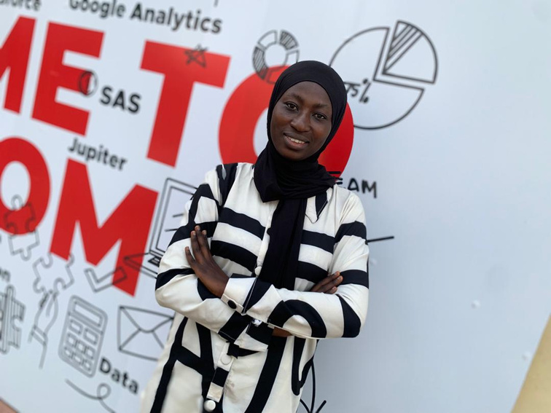



MEET THE TEAM
PENIEL TWUM
TENKOROMAH
JOLENE AMUI
BENNIAH EZUH
SHAMSIYATU
MURTALA
FELIX DUODU
GEORGE ANTWI
PRISCILLLA PWARORA

Slide 22








ACKNOWLEDGEMENTS

Slide 23
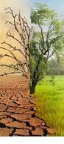
THANK YOU

Slide 24
REFERENCE LIST
1. ALI, A., AHMAD, A., & WANI, S.(2023). ANALYSIS OF WHEAT-YIELD PREDICTION USING MACHINE LEARNING MODELS UNDER CLIMATE CHANGE SCENARIOS. SUSTAINABILITY, 16(16), 6976. DOI:10.3390/SU16166976. RETRIEVED FROM [HTTPS://WWW.MDPI.COM/2071-1050/16/16/6976](HTTPS://WWW.MDPI.COM/2071-1050/16/16/6976)
2. ZHOU, L., & CHENG, H.(2024). ANALYSING THE EFFECT OF CLIMATE CHANGE ON CROP YIELD USING MACHINE LEARNING TECHNIQUES. SSRN. DOI:10.2139/SSRN.4802729. RETRIEVED FROM [HTTPS://PAPERS.SSRN.COM/SOL3/PAPERS.CFM?ABSTRACT_ID=4802729]
3. FAO. (2021). THE STATE OF FOOD AND AGRICULTURE 2021: MAKING AGRIFOOD SYSTEMS MORE RESILIENT TO SHOCKS AND STRESSES. FOOD AND AGRICULTURE ORGANIZATION OF THE UNITED NATIONS. RETRIEVED FROM HTTP://WWW.FAO.ORG/3/CB6030EN/CB6030EN.PDF
4. UNDP. (2023). CLIMATE CHANGE AND AGRICULTURE: SUB-SAHARAN AFRICA'S VULNERABILITY. UNITED NATIONS DEVELOPMENT PROGRAMME. RETRIEVED FROM HTTPS://WWW.UNDP.ORG/
5. WORLD BANK. (2016). CLIMATE CHANGE AND AGRICULTURE IN SUB-SAHARAN AFRICA: OPPORTUNITIES AND CHALLENGES. WORLD BANK GROUP. RETRIEVED FROM HTTPS://WWW.WORLDBANK.ORG/

